Slide 1
Power BI Services
First contact
Power BI Services
First contact

Slide 2
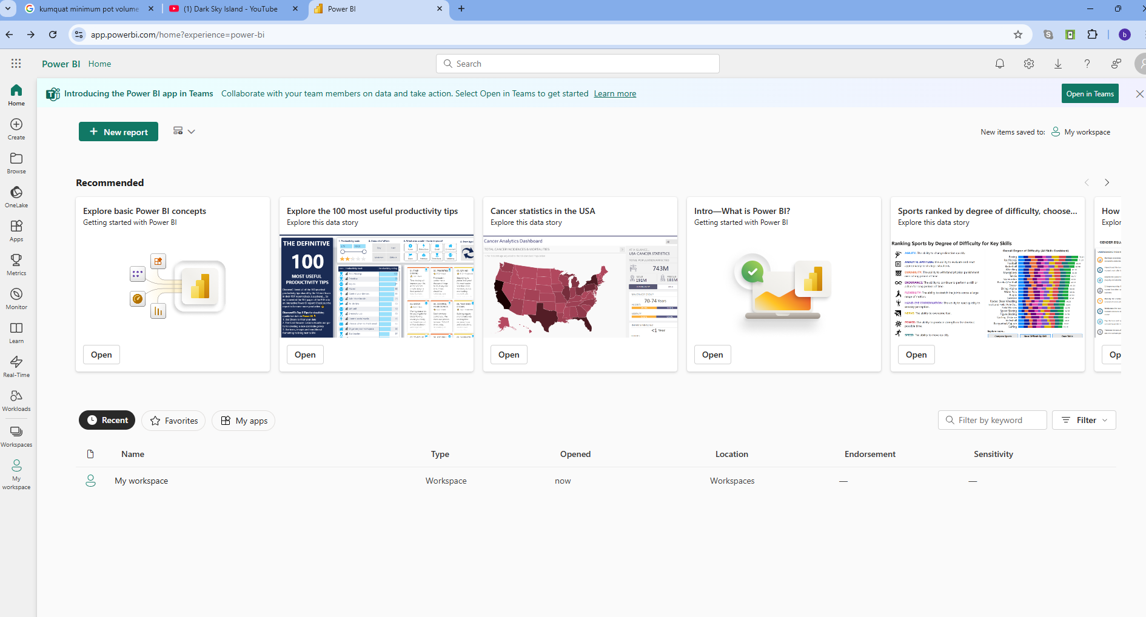
Power BI Services

Slide 3
Thank you
Thank you

